Slide 1

Collegiate Academy of Birdville 2021-2022 Report
September 15, 2022 Board Presentation

Slide 2
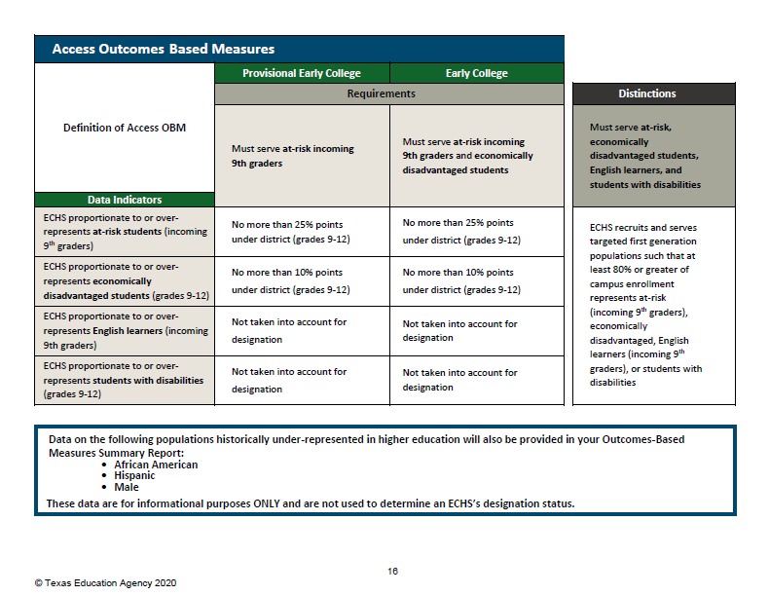
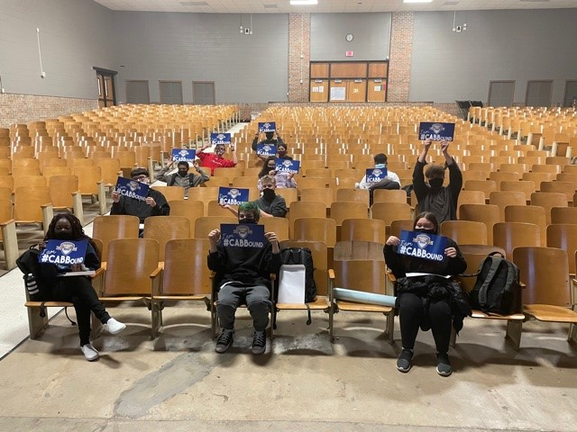

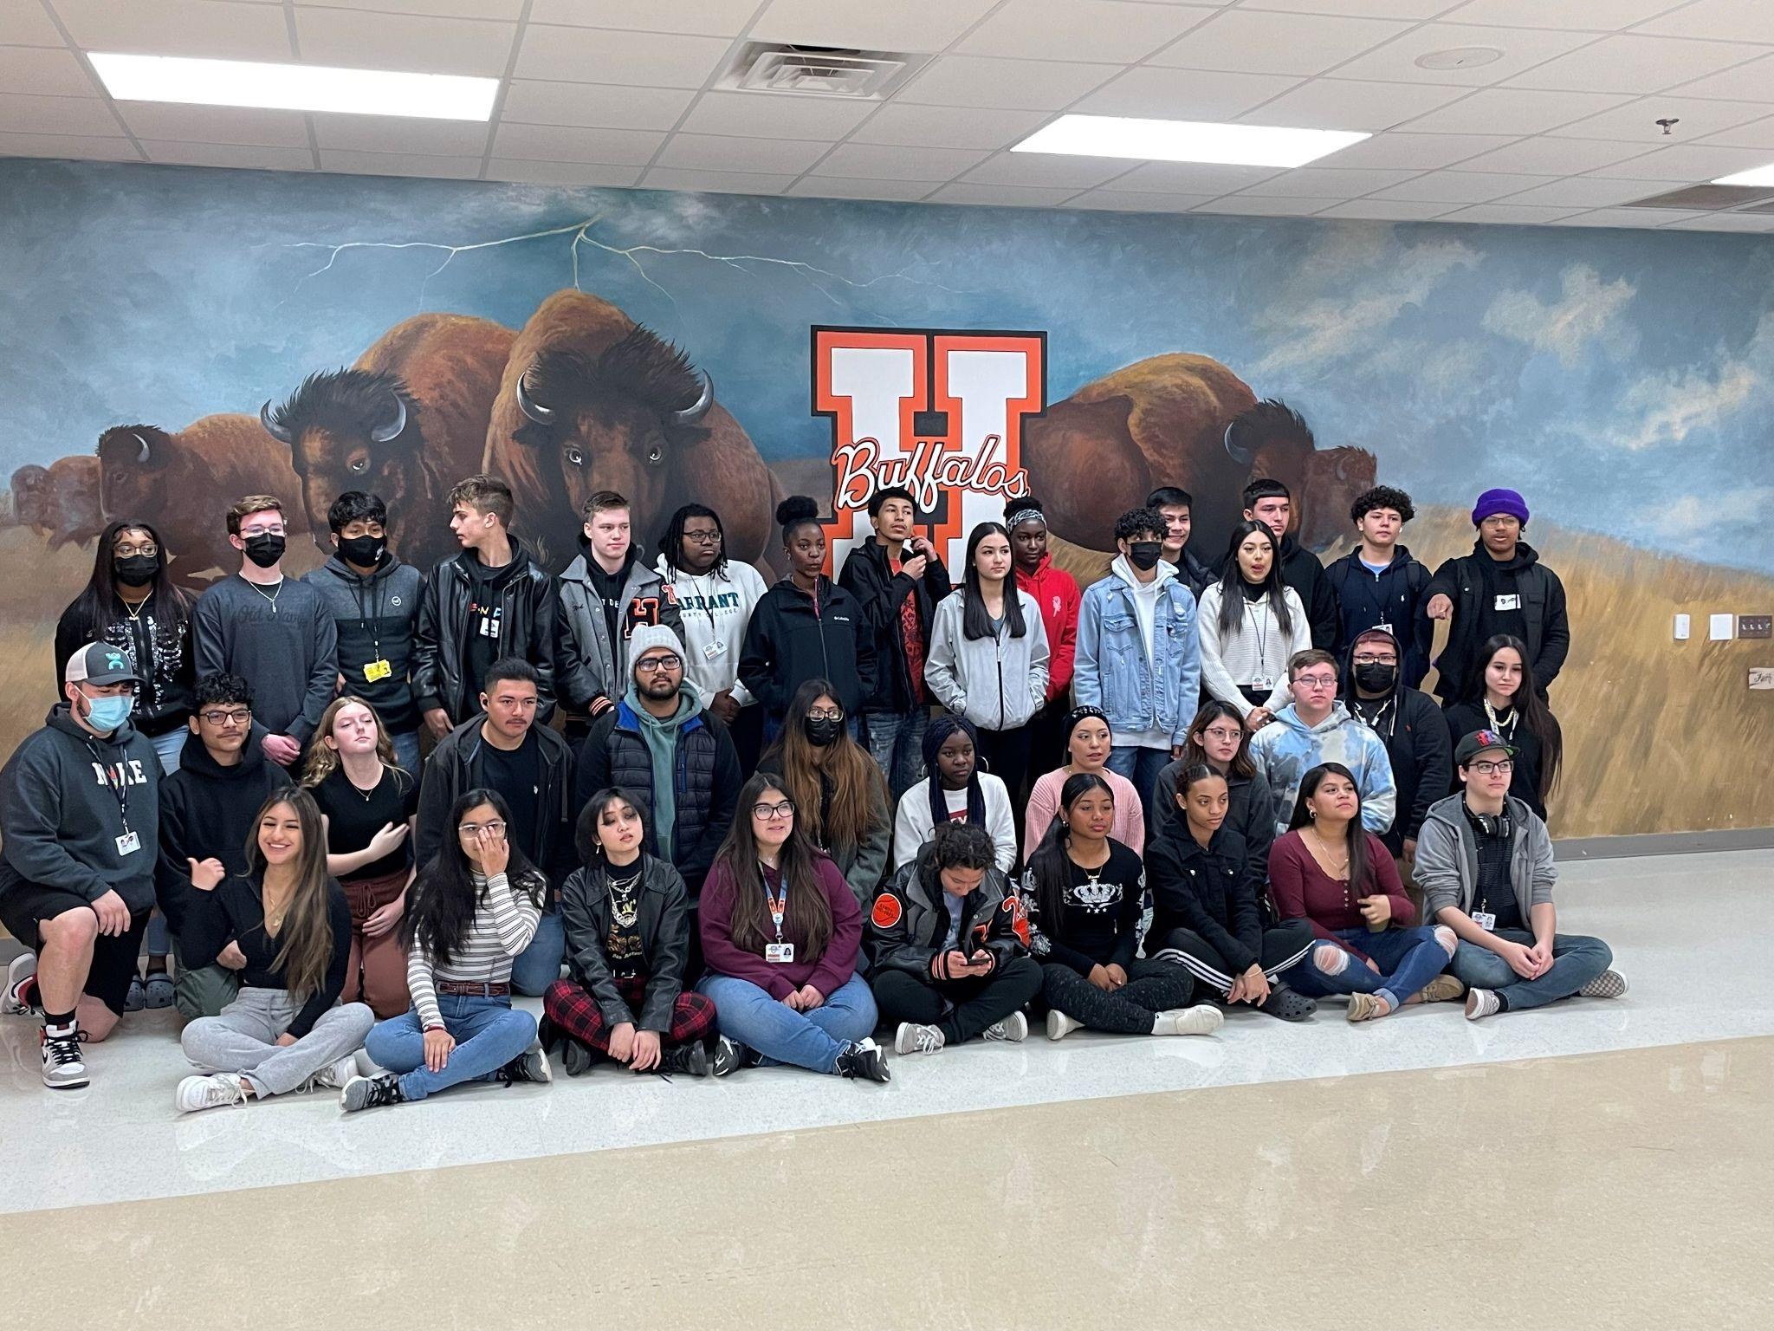
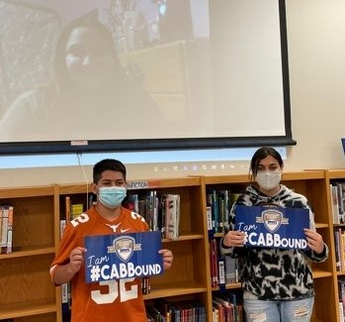
Benchmark 1: Target Population
The Early College High School shall serve, or include plans to scale up to serve, students in grades 9 through 12, and shall target and enroll students who are at risk of dropping out of school as defined by statute (Texas Education Code (TEC) §29.908) and the Public Education Information Management System (PEIMS) and who might not otherwise go to college.

Slide 3
Benchmark 1: Targeted Population
The Texas Education Agency has approved the 2022-2023 provisional designation application for the Collegiate Academy of Birdville. This provisional designation is for all Early College High Schools (ECHS) during the first four years of designation. Following its fourth academic year as a provisional ECHS, the Collegiate Academy of Birdville will automatically be measured against the designation outcomes-based measures.
While the provisional status provides several years to meet these outcomes-based measures, we are pleased to inform you that with recruitment efforts and use of the weighted lottery system, the Collegiate Academy has already met the requirements for the access measures for the representation of at-risk and economically disadvantaged students and have solid representation of African-American, Hispanic, and male students as indicated by Benchmark 1 of the ECHS Blueprint.
The Collegiate Academy of Birdville has met or exceeded the targets for Access Outcomes Based Measures in every year of operation due in large part to the excellent work of the Data Enterprise Systems group at BISD led by Mike Charland and their well-designed and extensively tested weighted lottery system. The CAB team was invited to present the system to other ECHS at a regional conference after the first year of implementation.

Slide 4
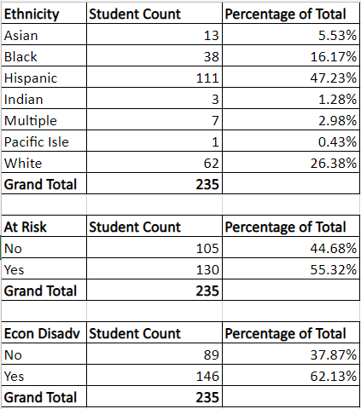
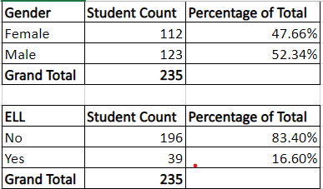
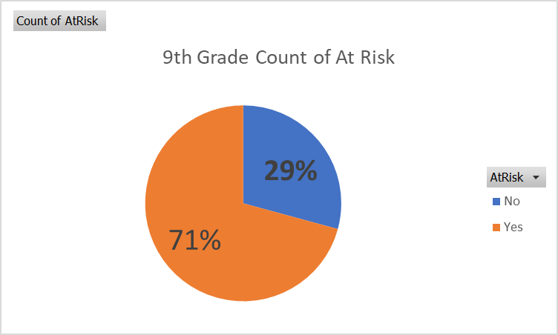
Current CAB Student Demographics

Slide 5

Access: Highlights of CAB Student Demographics
The October 2021-22 Snapshot Data compared to the current CAB student population demonstrates the alignment between our students and the targets set by TEA in the Benchmark 1 Blueprint. The 2022-23 October snapshot data will be compared to our current student population demographics to help set targets for earning distinctions in the area of access.
Two areas to highlight are:
2021-22 BSD Economically Disadvantaged population was 59.69%. The current population of incoming class of the CAB is 62.13% Economically Disadvantaged.
2022-23 At Risk for 9th grade students for the CAB is 71% - just 9 percentage points away from meeting the distinctions level of access. This may be an area to consider weighting the lottery more heavily in upcoming classes to earn this distinction.

Slide 6
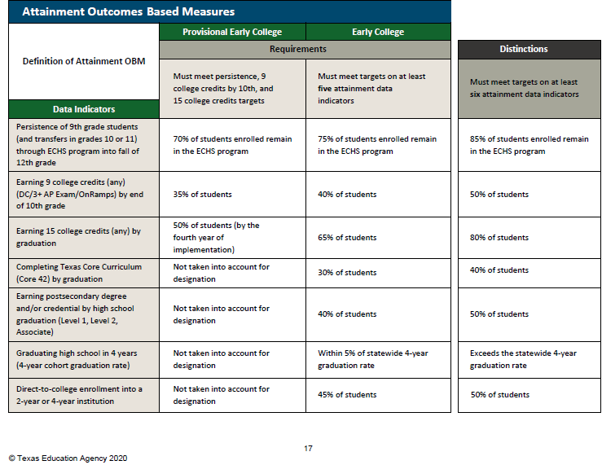
Benchmark 4: Curriculum and Support
The Early College High School shall provide a rigorous course of study that enables a participating student to receive a high school diploma and complete the Texas Higher Education Coordinating Board’s (THECB) core curriculum (as defined by Title 19 of the Texas Administrative Code (TAC) §4.28), obtain certifications, or earn an associate degree, or earn at least 60 credit hours toward a baccalaureate degree during grades 9 - 12. The ECHS shall provide students with academic, social, and emotional support in their course of study.
On target to earn attainment distinctions
Over 50% of students have earned 9 college hours by the end of 10th grade
Over 80% will have earned 15 hours by graduation
Over 40% of students will complete the Texas Core Curriculum by graduation
Projected: 72% of seniors will earn an Associate Degree in Spring of 2023 if all students stay the course
Projected: Over 50% of graduates will enroll directly in a 2 year or 4 year institution

Slide 7
Attainment: Highlights of CAB Progress
As noted on the previous slide, the Collegiate Academy is on track to meet the required 6 of 7 categories to earn distinctions for attainment. This progress is noteworthy at this point of implementation and is reflective of the tremendous work put in by CAB students, teachers, TCC instructors, and family members.
Target Goal: Retention of students entering the Collegiate Academy in the 9th grade.
We have had approximately 75% rate of retention based on students enrolled at snapshot who continue in the program after 9th grade - which meets the required criteria for an Early College High School designation.
The CAB instituted a policy the second year to raise the levels of enrollment back to our target of 60 students per grade level by allowing students who were on the waitlist from the lottery to join the CAB in their sophomore year, and should graduate over 55 students in every cohort.
Meeting the 85% retention rate for distinctions will be a top priority moving forward.

Slide 8
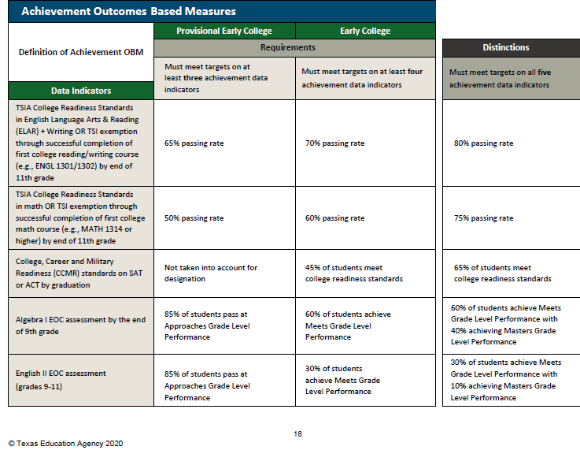
Benchmark 5: Academic Rigor and Readiness
The Early College High School shall administer a Texas Success Initiative (TSI) college placement exam (as defined by TAC §4.53) to all accepted ECHS students to assess college readiness, design individual instructional support plans, and enable students to begin college courses based on their performance on the exam.
On target for Early College Designation:
In 2021-22 EOC. Highlights:
100% of students performed at approaches grade level in Algebra 1, Biology, and U.S. History
98% of students performed at approaches grade level in English 1 and English 2
English 2: 94% students performed at meets grade level and 24% at masters grade level
On target for TSI Early College Designation:
All students Reading/Writing 67% Math 35% Class of ‘24 Reading/Writing 78% Math 72%
Class of ‘23 Reading/Writing 93% Math 80%
Goals set to target distinctions in TSIA Math and CCMR Readiness on SAT or PSAT

Slide 9
Achievement: Highlights of CAB Growth
The CAB is on track to meet requirements to be designated as an Early College High School, and is approaching all five categories to earn distinctions.
Targets for improvement to earn distinction status are increasing our Meets Grade Level performance in Algebra from 50% to 60% and Masters in Algebra from 21% to 40%.
We are also targeting improvement in the TSIA Math passing rate to produce the 75% passing rate needed for distinction.The addition this year of a Math instructor on the TCC campus will provide support for students who have not yet passed the Math TSIA2 in their Algebra II classes, and support for students taking college courses in Math.

Slide 10
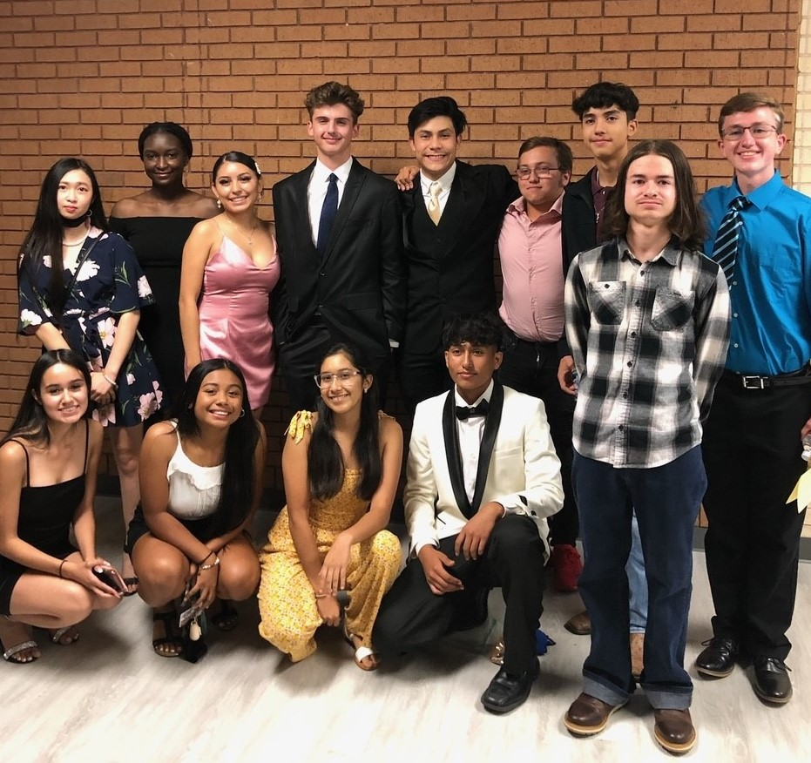
CAB PSAT Data 2022 Celebrations
National Hispanic Recognition:
Joshua Morales
Christian Esquivel
10% CAB Juniors with potential for College Board recognition in 2023 based on PSAT scores
NHS Inductees 2021

Slide 11
Benchmark 2: Partnership Agreement
The Early College High School shall have a current, signed memorandum of understanding (MOU), interlocal agreement (ILA) for each school year that:
Defines the partnership between the school district(s) and the institution(s) of higher education (IHE) and addresses topics including, but not limited to
the ECHS location;
transferability and applicability of college credit between a 2 year and 4 year institution;
the allocation of costs for tuition, fees, and textbooks; and student transportation;
States that the school district or charter in which the student is enrolled shall pay for college tuition (for all dual credit courses, including retakes), fees (including TSI administration fees), and required textbooks to the extent those charges are not waived by the partner IHE;
Defines an active partnership between the school district(s) and the IHE(s), which shall include joint decision making procedures that allow for the planning and implementation of a coherent program across institutions; and
Includes a data sharing agreement that promotes collaborative interventions with processes

Slide 12
Benchmark 3: P 16 Leadership Initiatives
The school district and institution(s) of higher education (IHE) partners shall develop and maintain a leadership team that meets regularly (e.g., quarterly or monthly) to address issues of design, implementation, ongoing implementation, and sustainability. Membership should include the Early College High School leader and individuals with decision making authority from the district(s) and IHE(s).
Benchmark 6: School Design
The Early College High School must provide a full day program (i.e., full day as defined in PEIMS) at an autonomous high school (i.e., a high school with ECHS leader assigned to ECHS responsibilities who has scheduling, hiring, and budget authority), an IHE liaison with decision making authority, and a highly qualified staff with support and training.

Slide 13




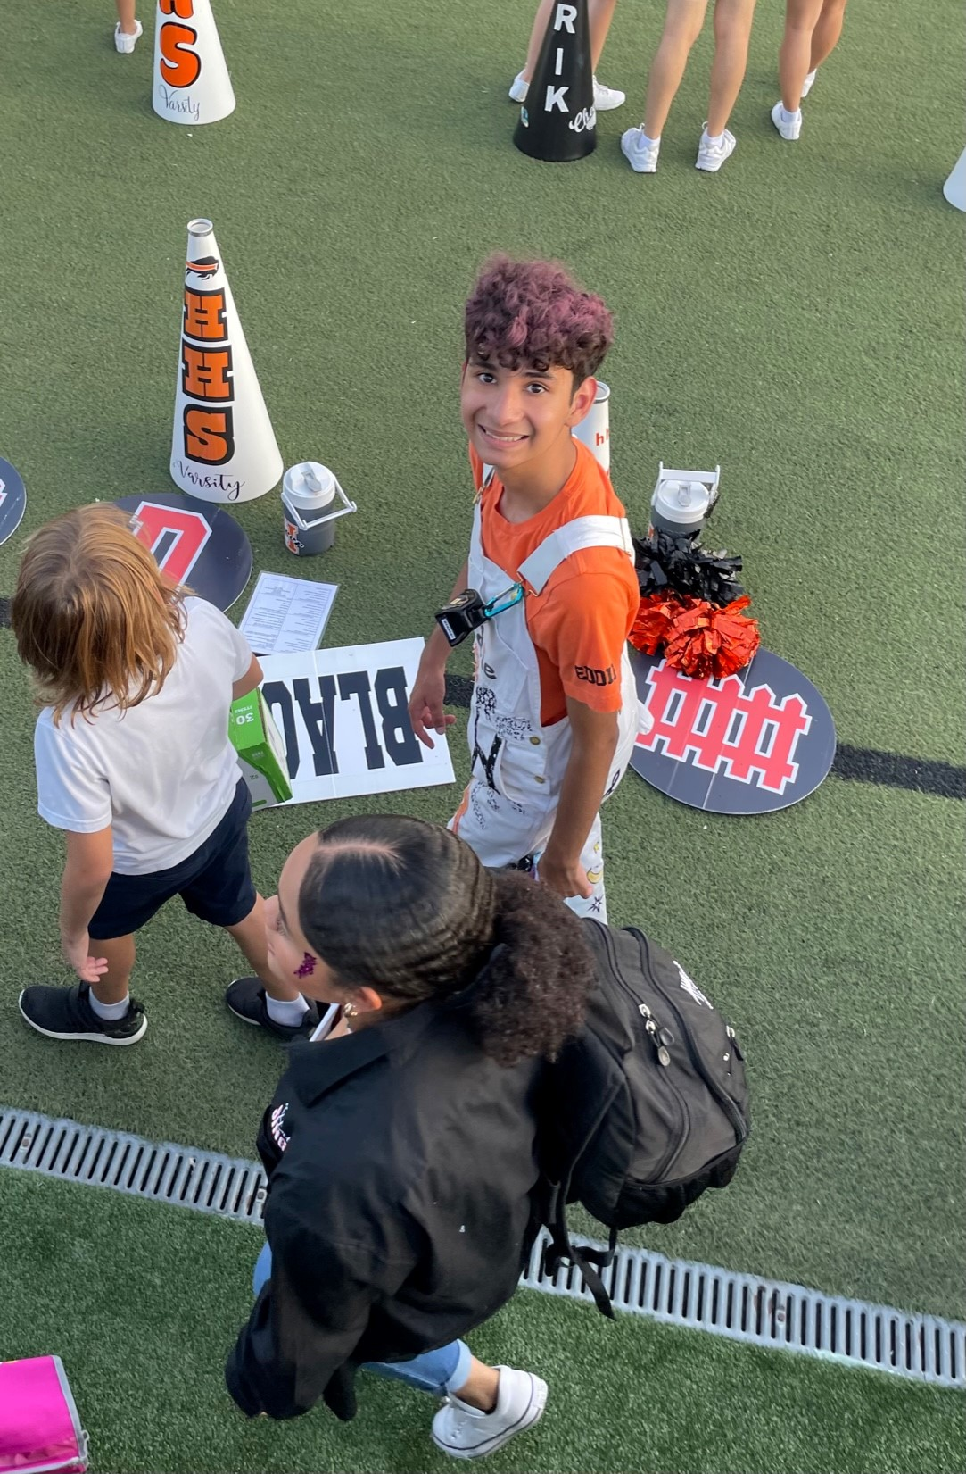
The School-within-a-School Model Benefits Students
CAB students are actively involved in Haltom High School -
15% are members of HHS band/ensemble
3% are members of HHS choir/ensemble
6% are members of HHS dance class/team
7% are involved in theater technology or theater performance classes
27% are taking a world languages class
2% are members of the HHS ROTC

Slide 14
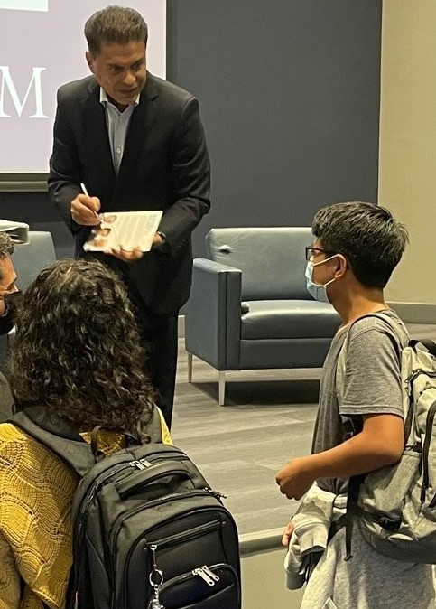
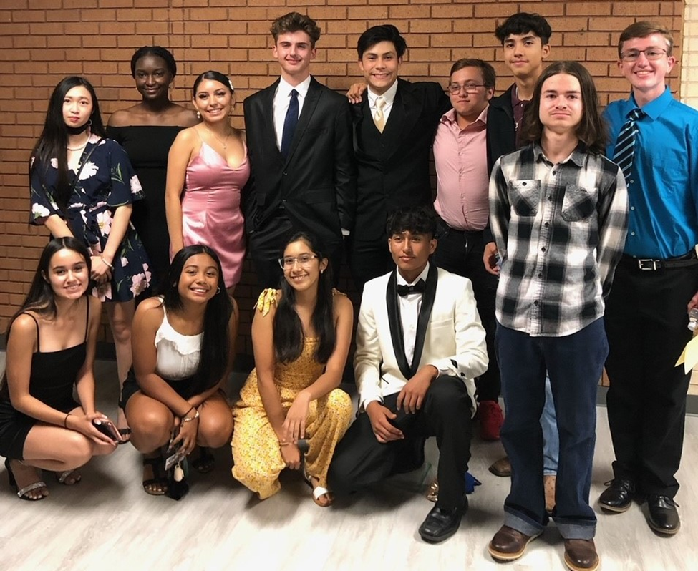
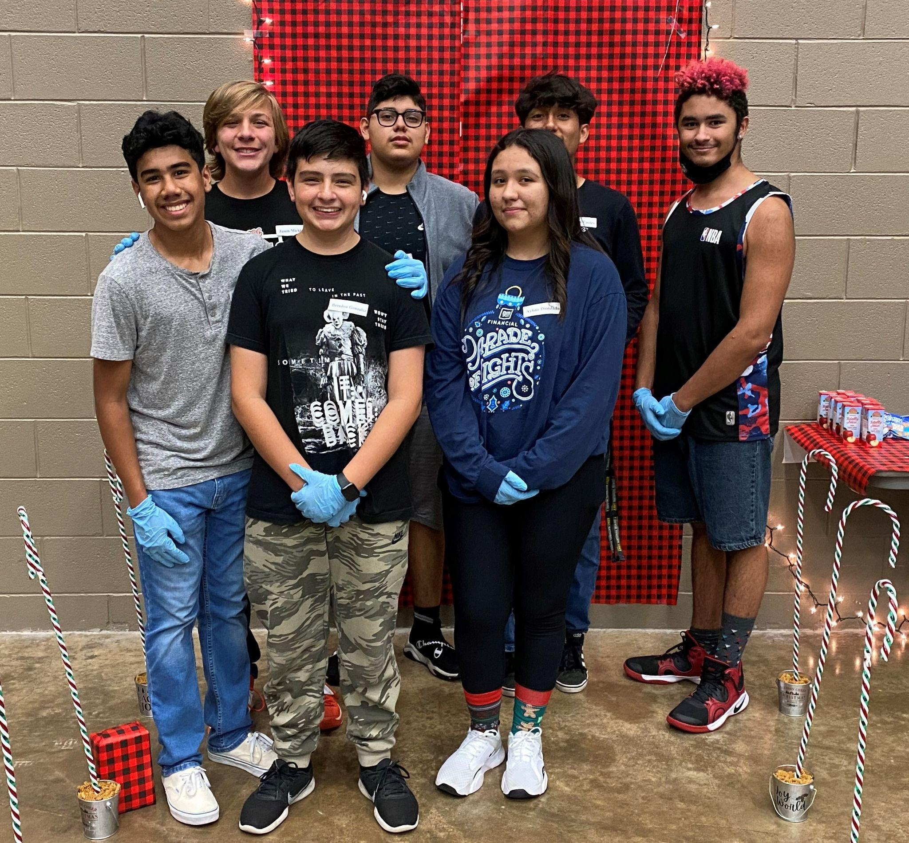
The School-within-a-School Model Benefits Students
CAB students are actively involved in Haltom High School -
2% are members of the HHS ROTC
12% are taking a CTE course (heavy enrollment in commercial photography and digital art animation)
20% are participating in an athletics program including: football, volleyball, baseball, softball, basketball, soccer, cross country, golf, gymnastics, and tennis
4% are taking a sports medicine class; 3 athletics trainers
100% of CAB students are enrolled in AVID
CAB students serve on the HHS Student Council, HHS National Honor Society, and the CAB Student Congress
CAB students participate in a wide array of additional activities and elective courses courses at HHS
CAB students completed 272 hours of community service in 2021-22

Slide 15
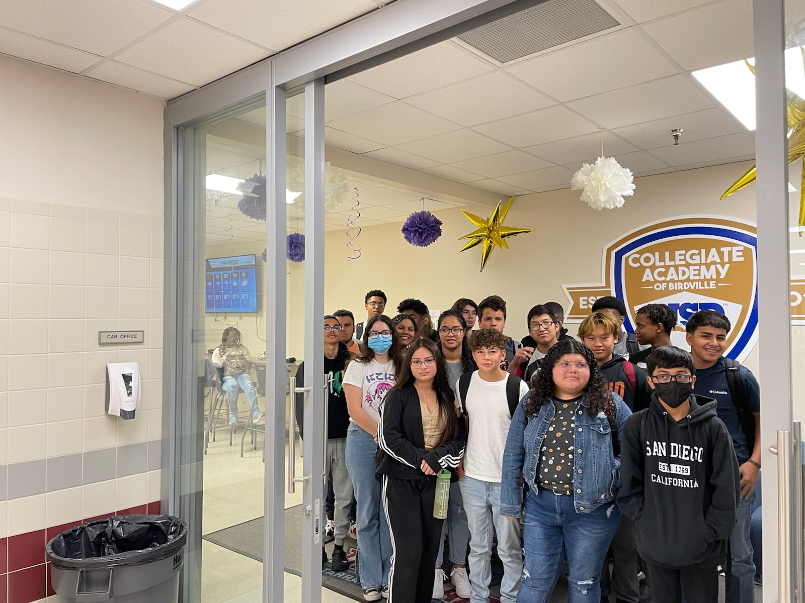
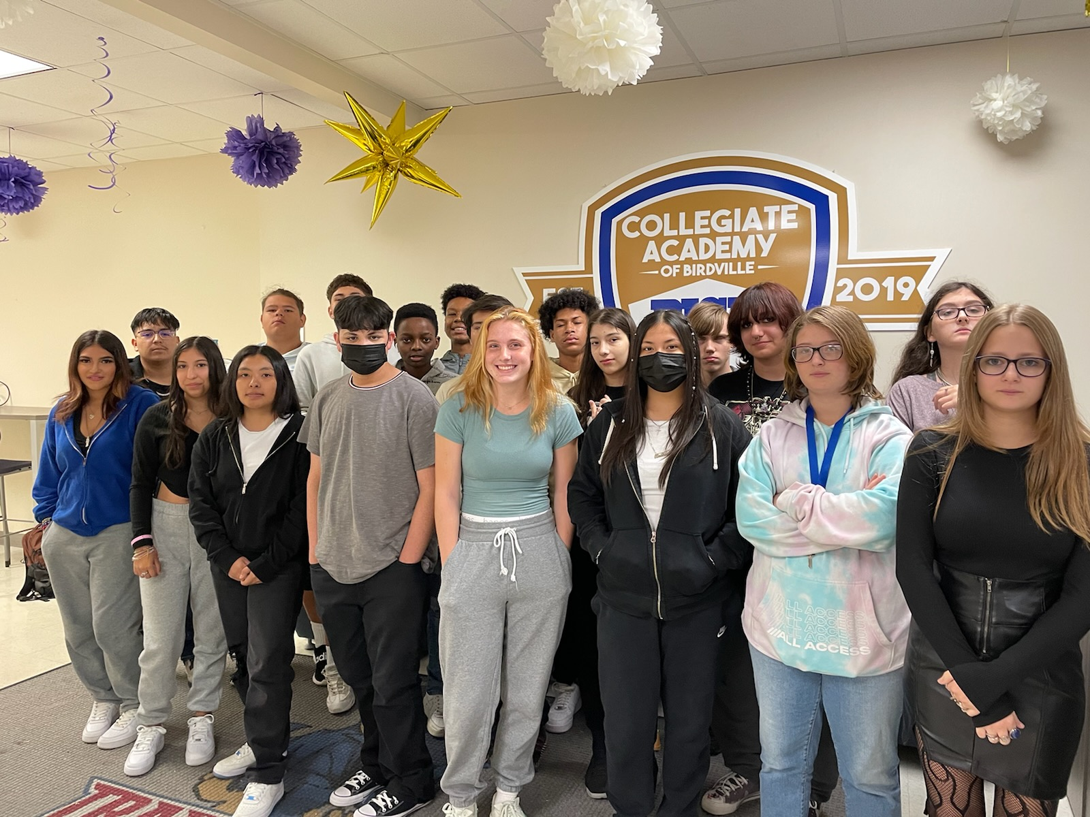
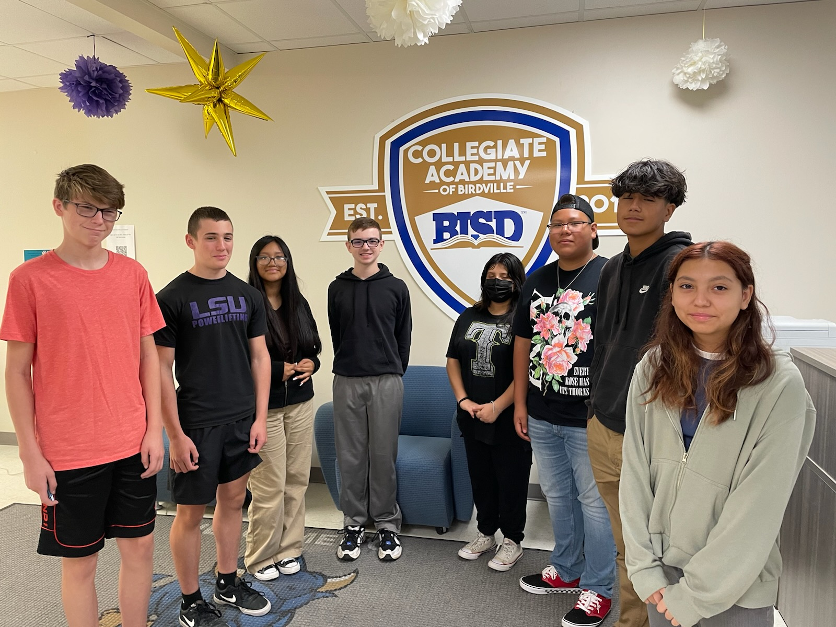
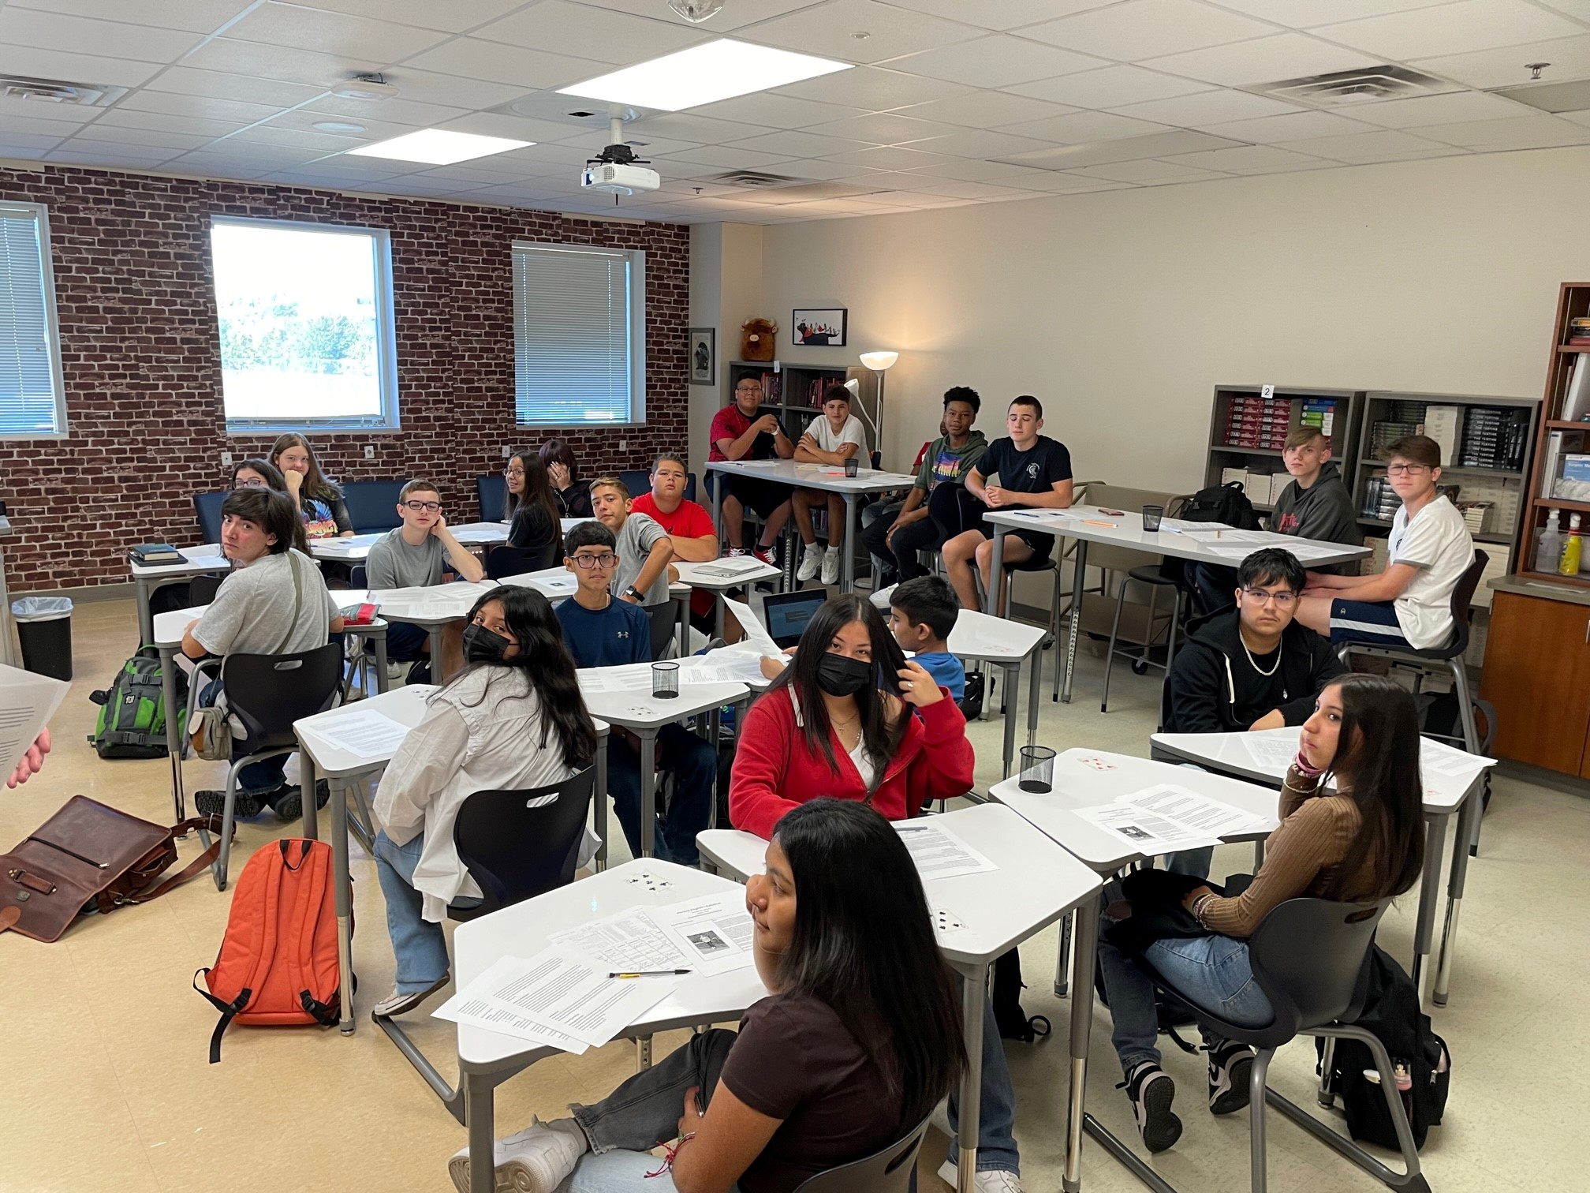
Welcome to the CAB! Incoming 9th Graders.

Slide 16
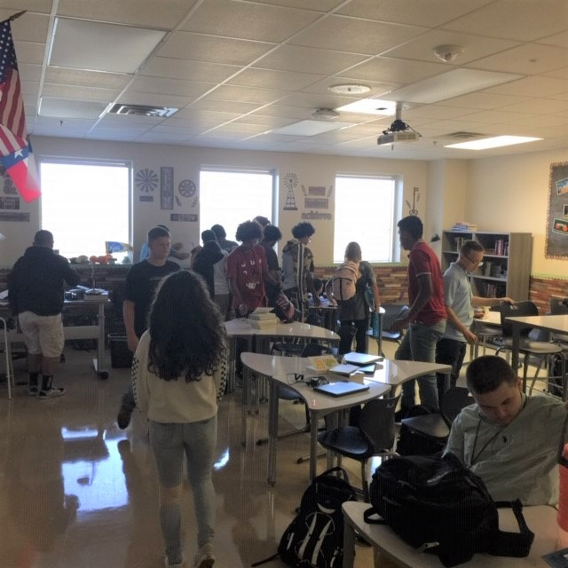
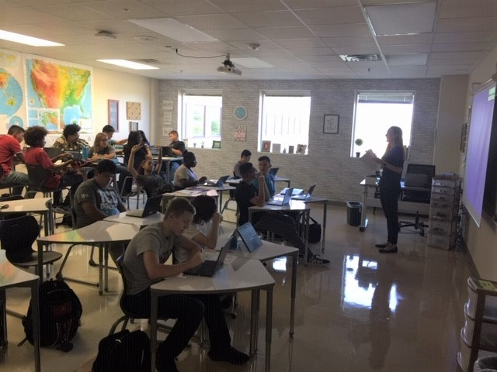
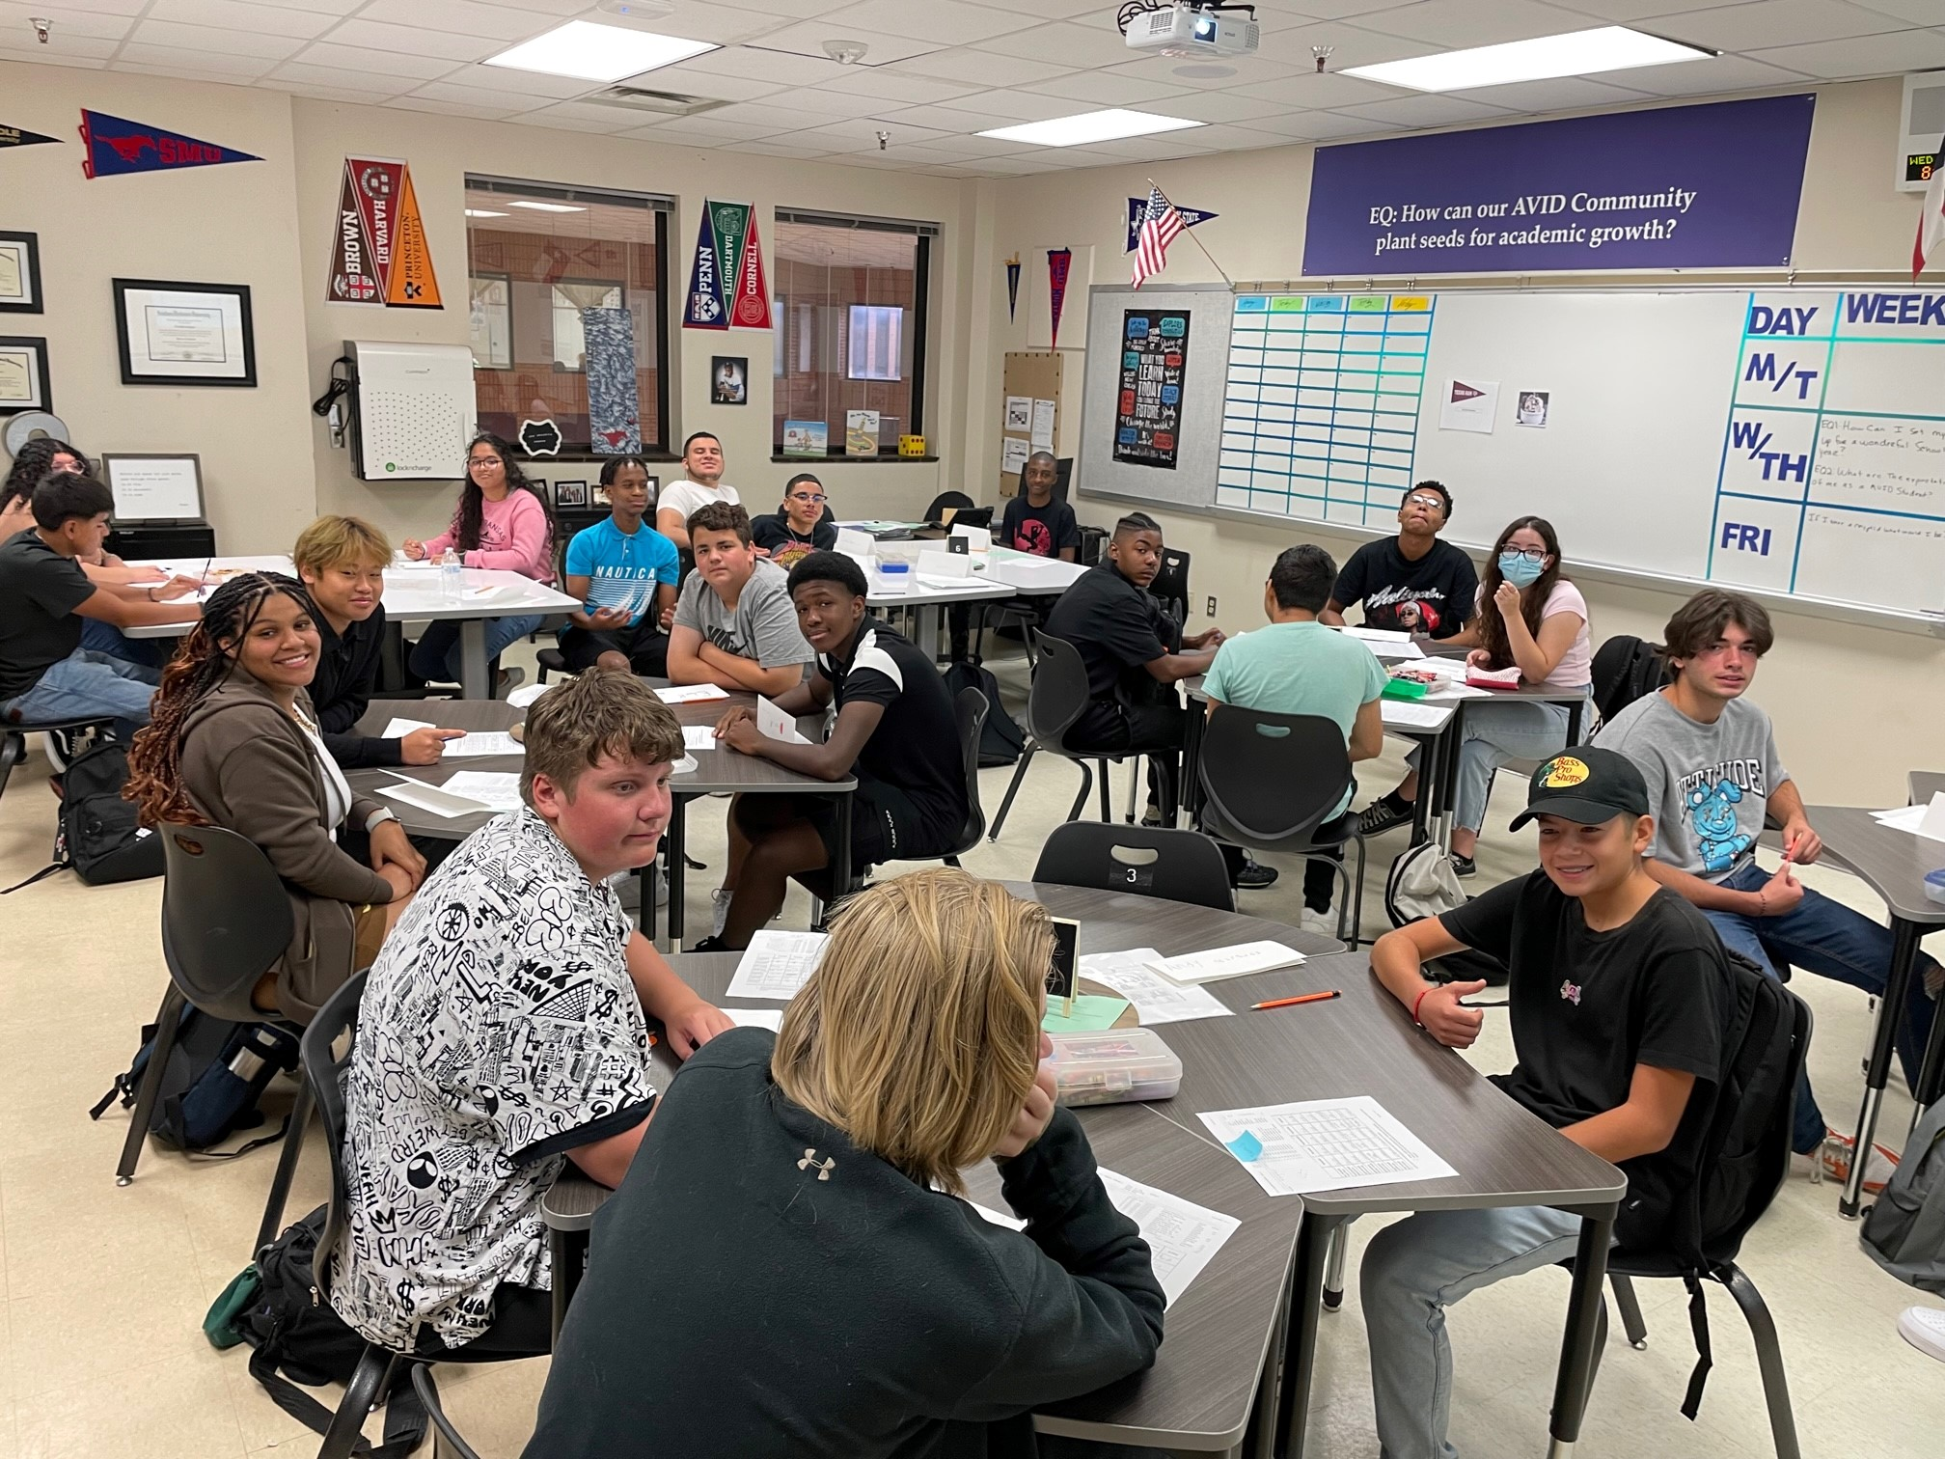
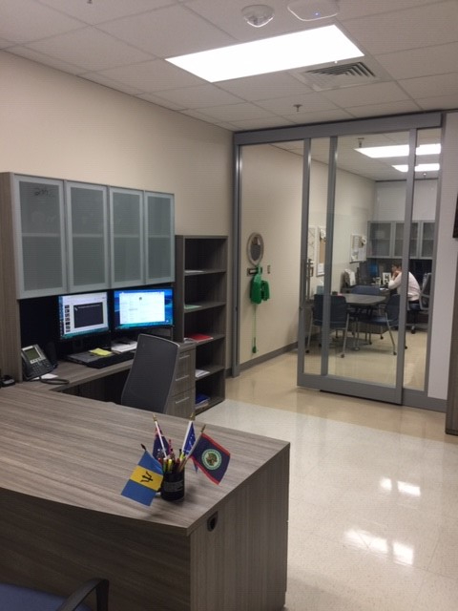
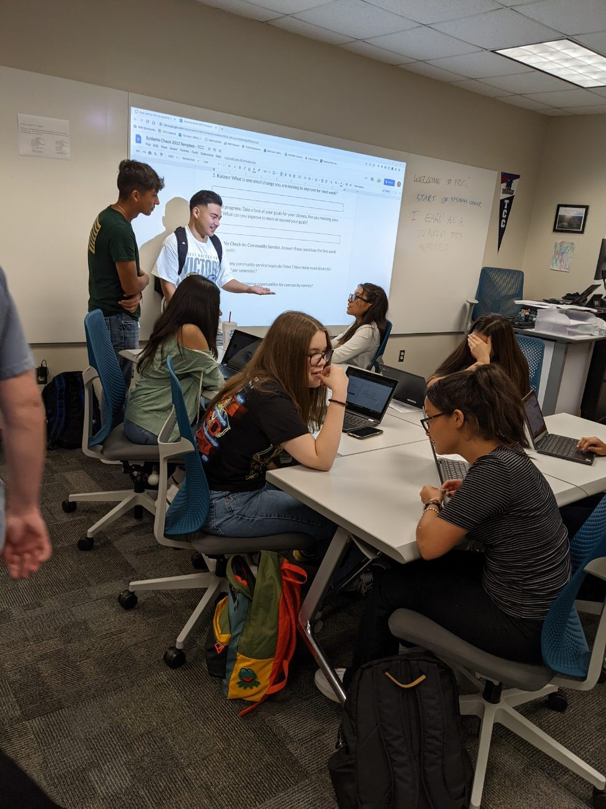
The Collegiate Academy of Birdville Facilities
The Collegiate Academy of Birdville would like to extend our thanks to the BISD School Board, Superintendent, and community members for their support of the 2018 Bond. The four classrooms (including a new science lab), collaborative learning spaces, and offices were ready for the first day of school. We would like to thank our hosts at Tarrant County College for the outstanding facilities provided to help our students meet their educational goals.

