Slide 1

Planning for Leading
How do we lead the change we want to see in our schools?

Slide 2
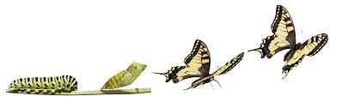
Making Connections
Problem of Practice
Planning for Learning Protocols
OHI
Learning Platform
Coaching

Slide 3




Multiple Dimensions of Data
Programs, Instructional Strategies, Classroom Practices, Assessment Strategies, Summer School, Finance, Transportation
Enrollment, Mobility, Attendance, Dropout/ Graduation Rate, Ethnicity, Gender, Grade Level, Teachers, Language proficiency
Demographics
School Processes
Perception
Perceptions of Learning Environments, Values and Beliefs, Attitudes, Questionnaires, Observations
Student
Learning
Standardized Tests, Norm/Criterion Referenced Tests, Grade Point Average, Formative Assessment, Performance Assessment
Copyright ©1991-2005 Education for the Future Initiative, Chico, CA
Notes:
Clark

Slide 4
Adaptation
…is that ability to tolerate stress and maintain stability while coping with demands of the environment
…is the ability to adapt and change in order to achieve our school-wide goals and objectives.
Notes:
Presentation slide
What are we coping with? Are these typically internal or external forces? How does our level of Goal Focus impact our willingness to adapt?

Slide 5
Adaptation is impacted by three key factors
  The degree to which the principal is receptive to these external demands for change (resistant to advocate)
  The degree to which faculty members are willing and able to make these needed changes.
  The degree to which the school/community support these changes
Notes:
Presentation slide
What are we coping with? Are these typically internal or external forces? How does our level of Goal Focus impact our willingness to adapt?

Slide 6

Leader-Centered Model
Our level of understanding and commitment to district-wide initiatives is the dominant filter through which we transmit our messages to members of our teams.
Notes:
6

Slide 7
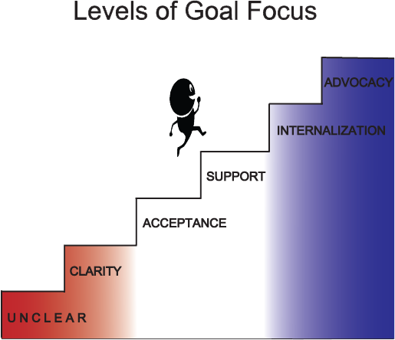

Six Stages
What messages have I been sending about district-wide change efforts?
The “how”!
LEVELS OF ADAPTATION
The Learning Platform
Transformational
Problems of Practice
Paradigm shift: from Teaching
To learning
Notes:
7
This is a good place to get their voice in the room. Let them share in pairs the because statement and then let them report out. You will get some powerful statements!

Slide 8
Prerequisites for change
They must see a need to change!
They must believe they are able to make the needed changes!
They must trust that system will support them in these change efforts.
They must be willing to spend the time and energy necessary!
Therefore, we need to . . .

Slide 9
Therefore, we need to . . .
Invest more time in helping staff see the need to change
Invest in resources that will help build confidence in their capacity to change
Provide the time for staff to learn about and implement change
Build leadership density throughout all levels of the system
Stay focused and be intentional in our work

Slide 10
LOL Reflection
Reflect on your experience with the Planning for Learning Protocol during LOL
Share feedback you have received from your LOL team
Share actions you may have already taken to begin leading the use of protocols on your campus

Slide 11

Planning for Learning Protocol
Let’s take a moment to get crystal clear about…
The purpose of the P4L protocol
The components of the P4L protocol
The progression of the P4L protocol – why is the order important?
DISCUSS

Slide 12
GOALS
Elevate the COGNITIVE DISCOURSE within PLCS
the THINKING represented in the protocols becomes AUTOMATIC
PLCs produce high-quality, standards-based lessons focused on STUDENT LEARNING rather than teaching.
use of BIRDVILLE ISD PROTOCOLS for Planning, Using Data, and Reflecting on Practice
through the
so that
and
Notes:
Clark

Slide 13
Planning for Learning Protocol:
It’s a Process
Select the standard(s): Leading, Partner, Process
Standard Clarification Documents
Evidence of Learning:
Formative, Summative
Student Tasks
Strategies and Structures
Resources
Procedure
Accommodations/ Modifications/ Extensions
Reflection
Notes:
Solley and Smith (this can be up during reflection time as LOLs)

Slide 14
Process = Output
Input
Process
Output
Notes:
Clark

Slide 15
Process = Output
Consistent Processes
High-Performing Culture
develop
Notes:
Clark

Slide 16
Accountability vs. Responsibility
Accountability
Responsibility
Notes:
Clark

Slide 17
Planning for Teaching vs. Planning for Learning
Planning for Teaching
Planning for Learning
Select Topic → Plan Lesson → Create Assessment
Standards → Clarification Documents → Evidence of Learning → Student Tasks → Strategies and Structures → Resources → Differentiation
Divide and Conquer Approach to Planning
Collaborative Approach to Planning: All teachers deeply understand lesson and purposes behind its design
Not necessarily aligned to standards
Backward design: lessons tightly aligned to leading students to mastery of the standards
Focused more on the teacher and what needs to occur rather than students and what/how they will learn
Focused on student learning and the experiences required in order for students to be able to demonstrate mastery of that learning
Notes:
Clark

Slide 18
Planning for Leading
How do we lead the change we want to see in our schools?

Slide 19
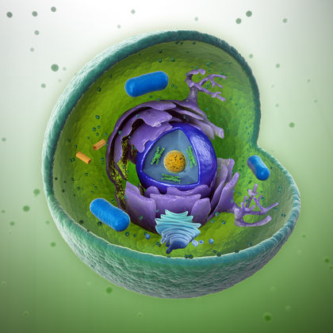
Cell Theory

Slide 20
Tenets of the Modern Cell Theory
All living things are composed of cells
Cells are the structural and functional units of all living things
All new cells arise from pre-existing cells

Slide 21
Characteristics of living things
All living things
  Move
  Use energy
  Respond to stimuli
  Develop and grow
  Reproduce

Slide 22
Organization of life
Cell
Tissue
Organ
Organ System
Organism
Population
Ecosystem
  Move
  Use energy
  Respond to stimuli
  Develop and grow
  Reproduce

Slide 23
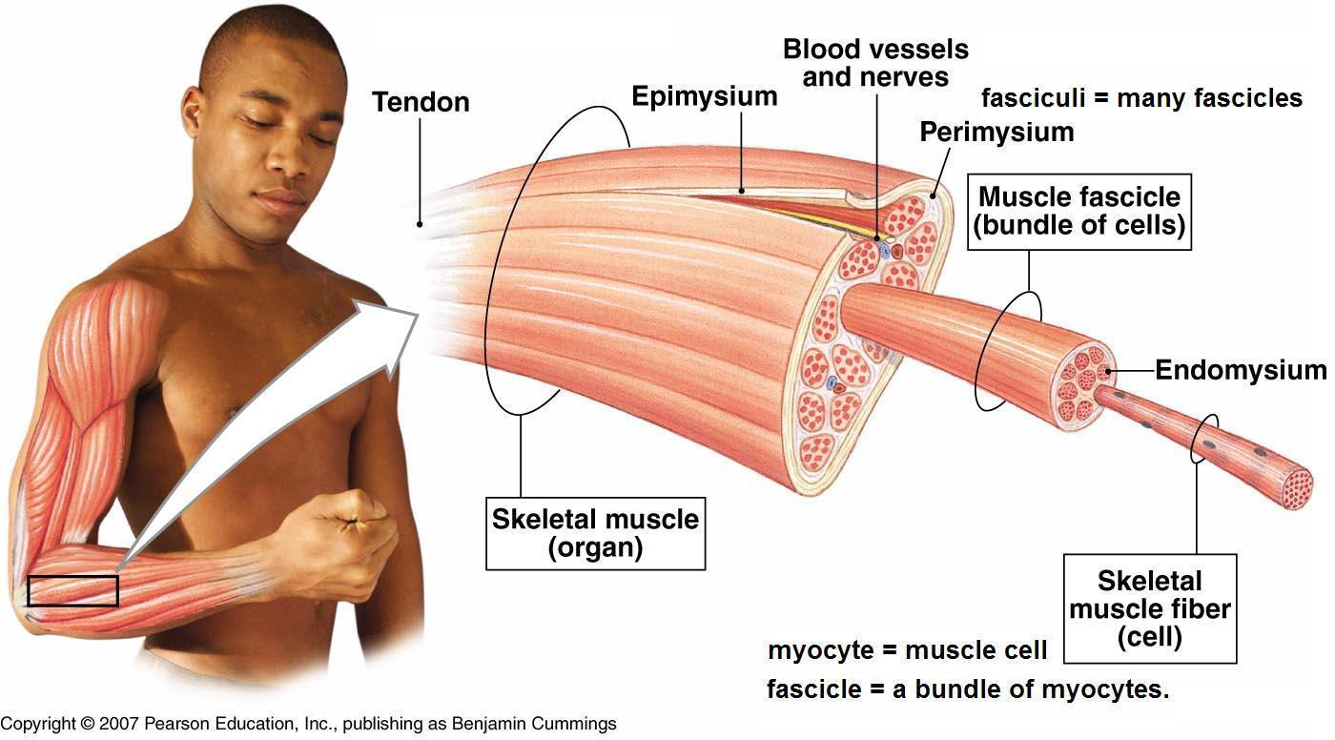

Slide 24
Learning Objectives
Deeply understand the knowledge and skills required for teachers to plan for learning
Engage in the Planning for Leading Protocol to apply backward design to lead teachers in becoming masters of planning for learning
Elevate cognitive discourse in collaboration with peers as you work toward a common goal

Slide 25
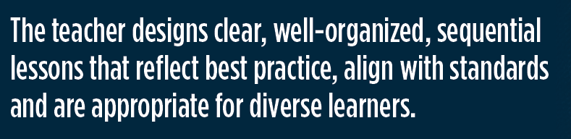
Planning for Leading
What is the outcome of the protocols?
Think of this as a “standard” for our teachers. Discuss how focusing on standards for educators could improve our work as leaders.
§149.1001.
Notes:
Add citation

Slide 26
Power of Conversation
“I’ve seen that there is no more powerful way to initiate significant change than to convene a conversation.”
                - Margaret Wheatley
Protocols ARE conversation
guides
Notes:
Clark

Slide 27
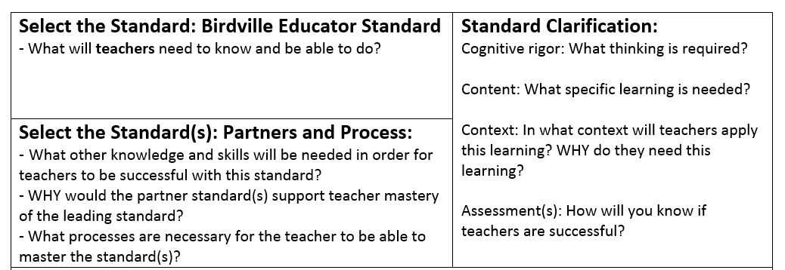
P4Leading: Let’s Begin
Design clear, well-organized, sequential lessons that reflect best practice, align with standards, and are appropriate for diverse learners.

Slide 28
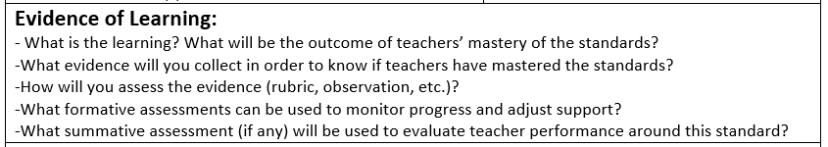
P4Leading
Design clear, well-organized, sequential lessons that reflect best practice, align with standards, and are appropriate for diverse learners.

Slide 29
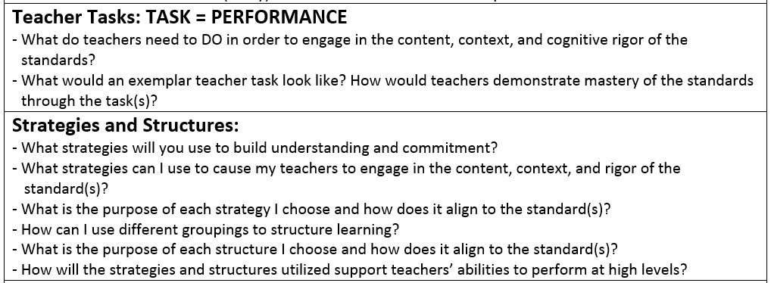
P4Leading
Design clear, well-organized, sequential lessons that reflect best practice, align with standards, and are appropriate for diverse learners.

Slide 30
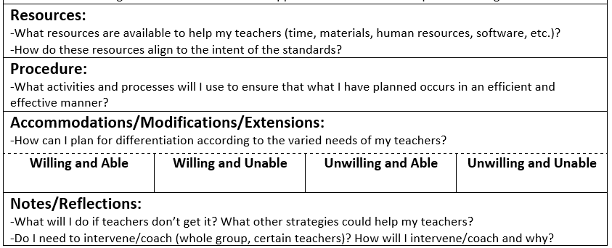
P4Leading
Design clear, well-organized, sequential lessons that reflect best practice, align with standards, and are appropriate for diverse learners.

Slide 31

Reflection
Share your initial thoughts: how does planning for leading improve planning for learning?
What would you have overlooked if you had not engaged in conversations around this protocol?
How is planning for the learning of students mirrored in planning for leading teachers? WHY should it be so similar? HOW does it need to be different?
What are your next steps to increase the capacity of teachers in PLCs to plan for learning?

Slide 32

Thought Challenge
Are you TEACHING if nobody is LEARNING?
Are you COACHING if nobody is SHARPENING THEIR SKILLS?
Are you LEADING if nobody is MOVING FORWARD?

Slide 33
Campus PD: February 16
  You are encouraged to set your standards for the day and engage in the protocol to ensure the plans you make are aligned to the outcomes you desire for your teachers
  Please submit a form for your campus session if you have not done so already
  Each campus will have its own course for registration purposes - we will add any details you include in your form
  Certain groups will be meeting together off campus: Fine Arts, ?
  Registration website will go live February 4.
  Registration will close February 12.

Slide 34

Plus/Delta

